Slide 1
Blockchain in L a n d
R e g i s t r y
By
Manikandan P

Slide 2
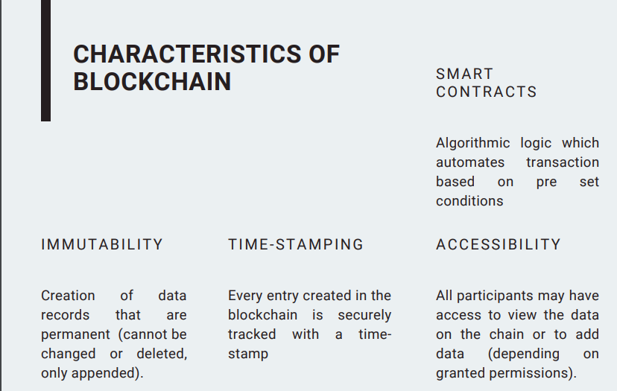

Slide 3
COMMON CHALLENGES:
The land registration process is still mostly complicated and inefficient in many parts of India
TIME DELAYS
FRAUD
HUMAN ERRORS
UNNECESSARY THIRD PARTIES

Slide 4
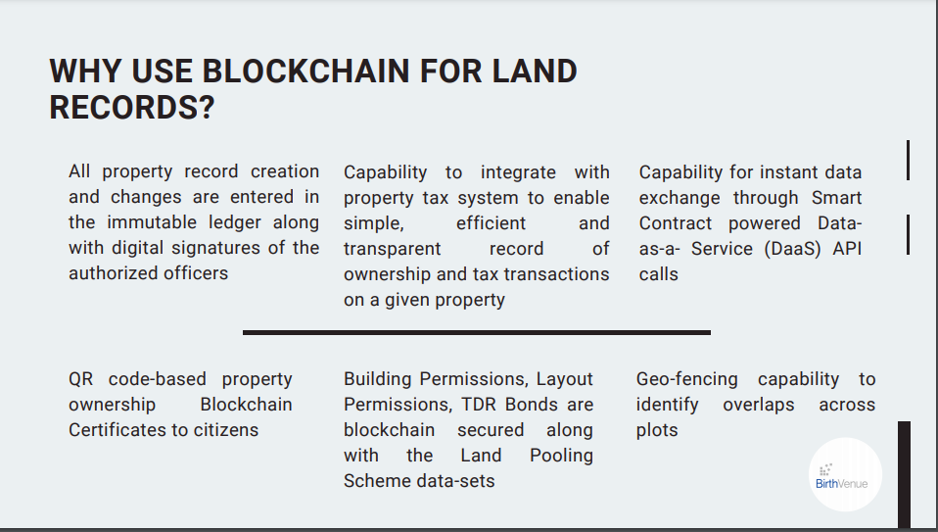

Slide 5
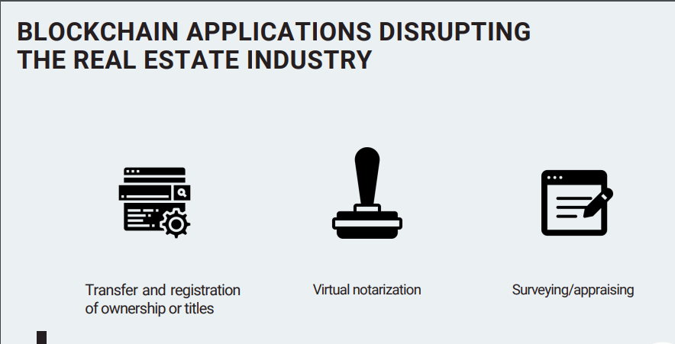

Slide 6
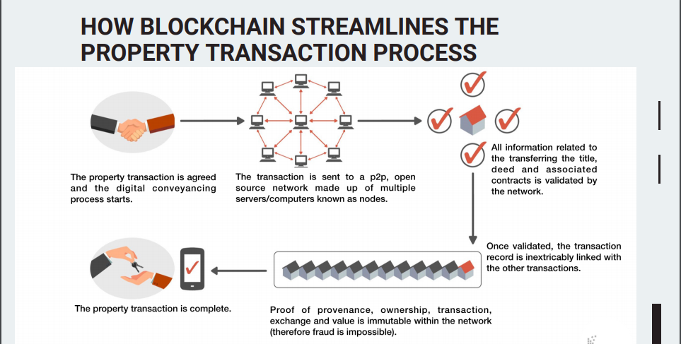

Slide 7
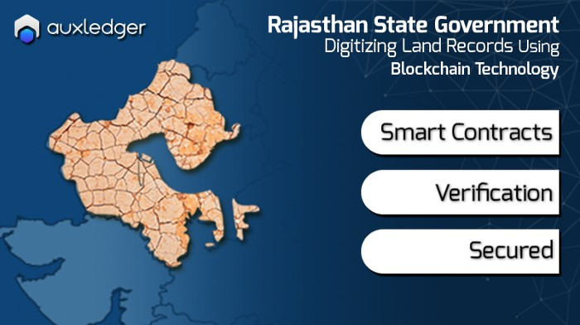
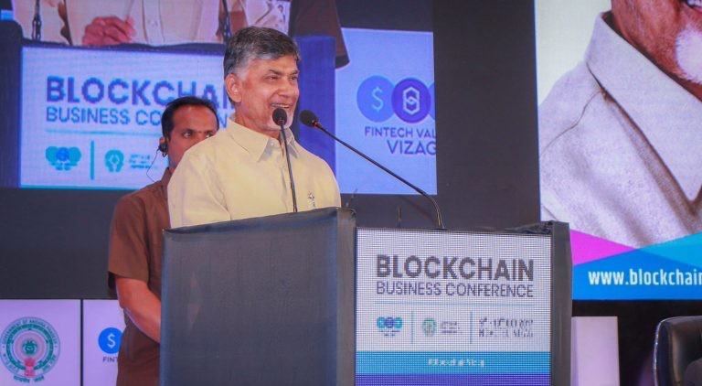
PRACTICAL IMPLEMENTATIONS IN INDIA
RAJASTHAN
ANDRAPRADESH

Slide 8
